Slide 1
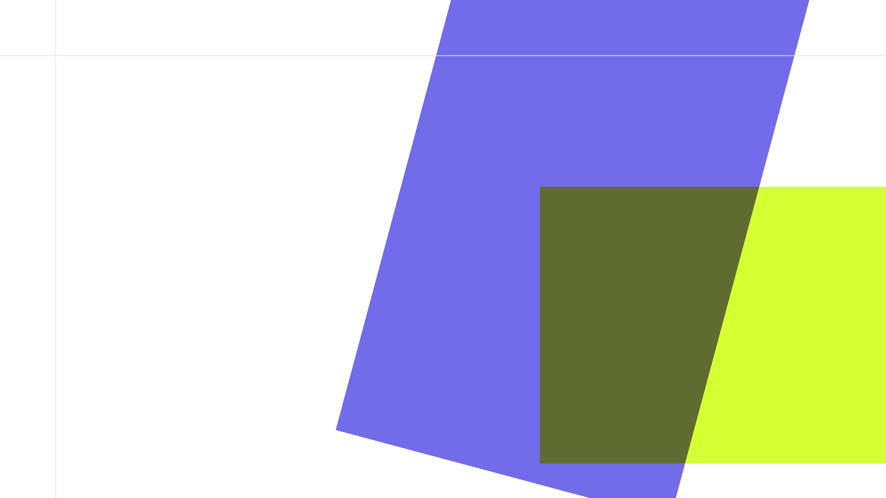
FUSE VAULT
Real-Time Hybrid Stablecoin Vault
Team
Cauchy | 卢博文 | 唐彬杰 | Peggy
Built for 2026 GWDC Hackathon

Slide 2
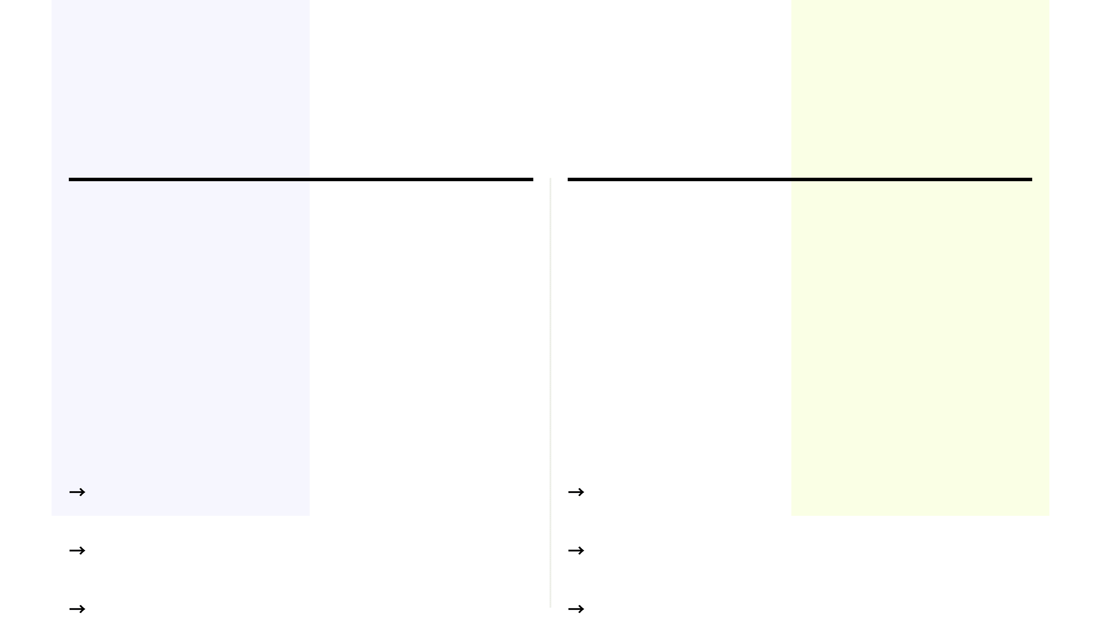
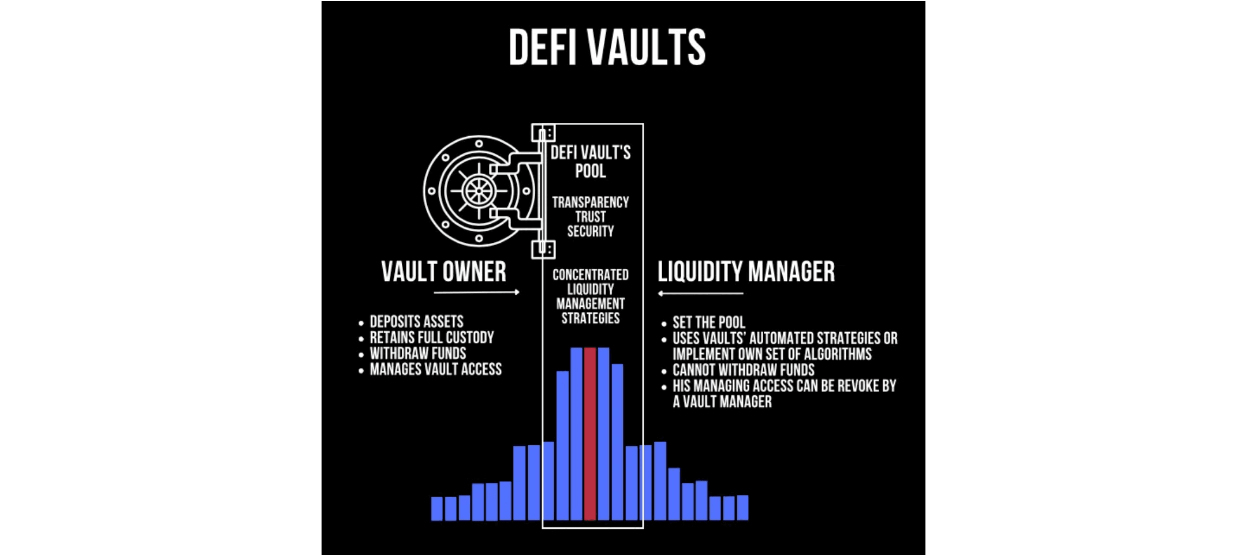
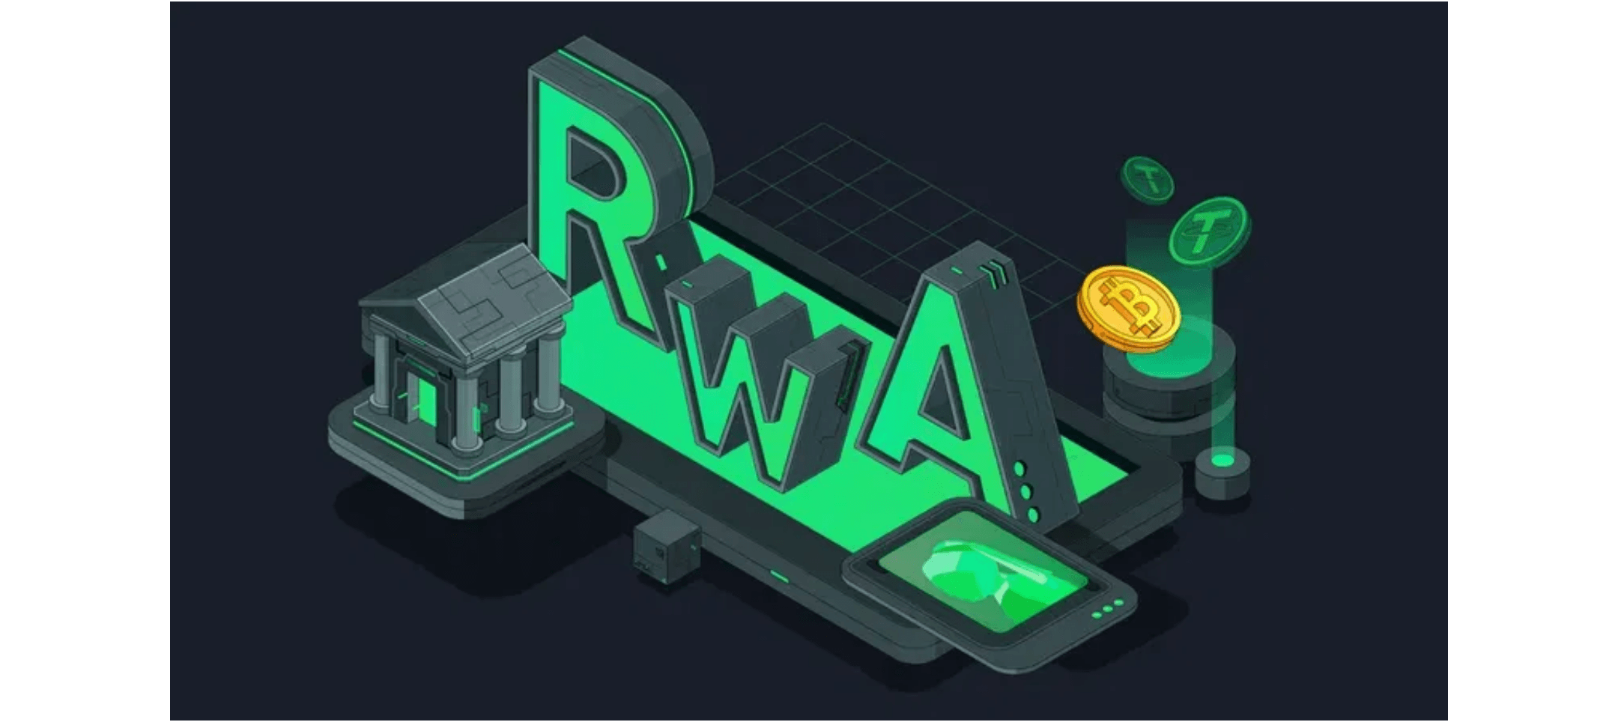
THE SPLIT
Current Market Fragmentation
DeFi Vaults
RWA Vaults
→
Real-Time Settlement
→
Asynchronous Settlement
Instant deposit & withdrawal
T+1 or Operator confirmation
→
On-Chain Native
→
Off-Chain Dependency
THE GAPUsers are forced to manage separate positions, preventing unified yield capture.
Fully automated smart contracts
Requires legal & banking rails
→
High Volatility
→
Stable Yields
Yields fluctuate with market
Backed by T-Bills, Gold, etc.

Slide 3

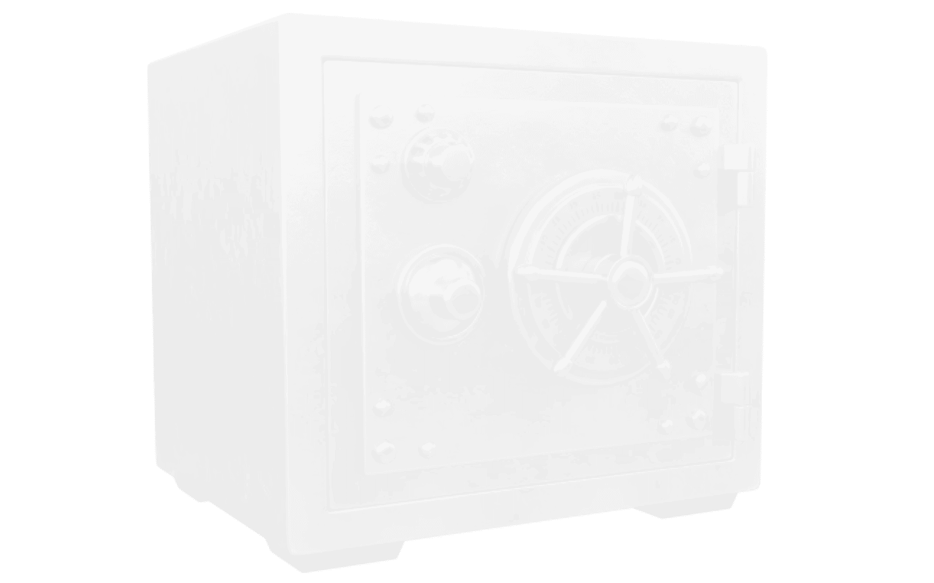
CORE PAIN POINTS
01
02
Missing Composability
Missing Observability
Current standards cannot support both Real-Time (DeFi) and Asynchronous (RWA) settlement in a single vault.
Traditional vaults only show static "Expected APY" without real-time performance data or fee transparency.
The Consequence:
The Consequence:
Users are forced to manage two separate positions.
"Black Box" investing. Users cannot verify real
Capital is fragmented, and share tokens cannot be
unified for downstream DeFi usage.
drawdowns, fee deductions, or the stability of the
underlying RWA assets.

Slide 4
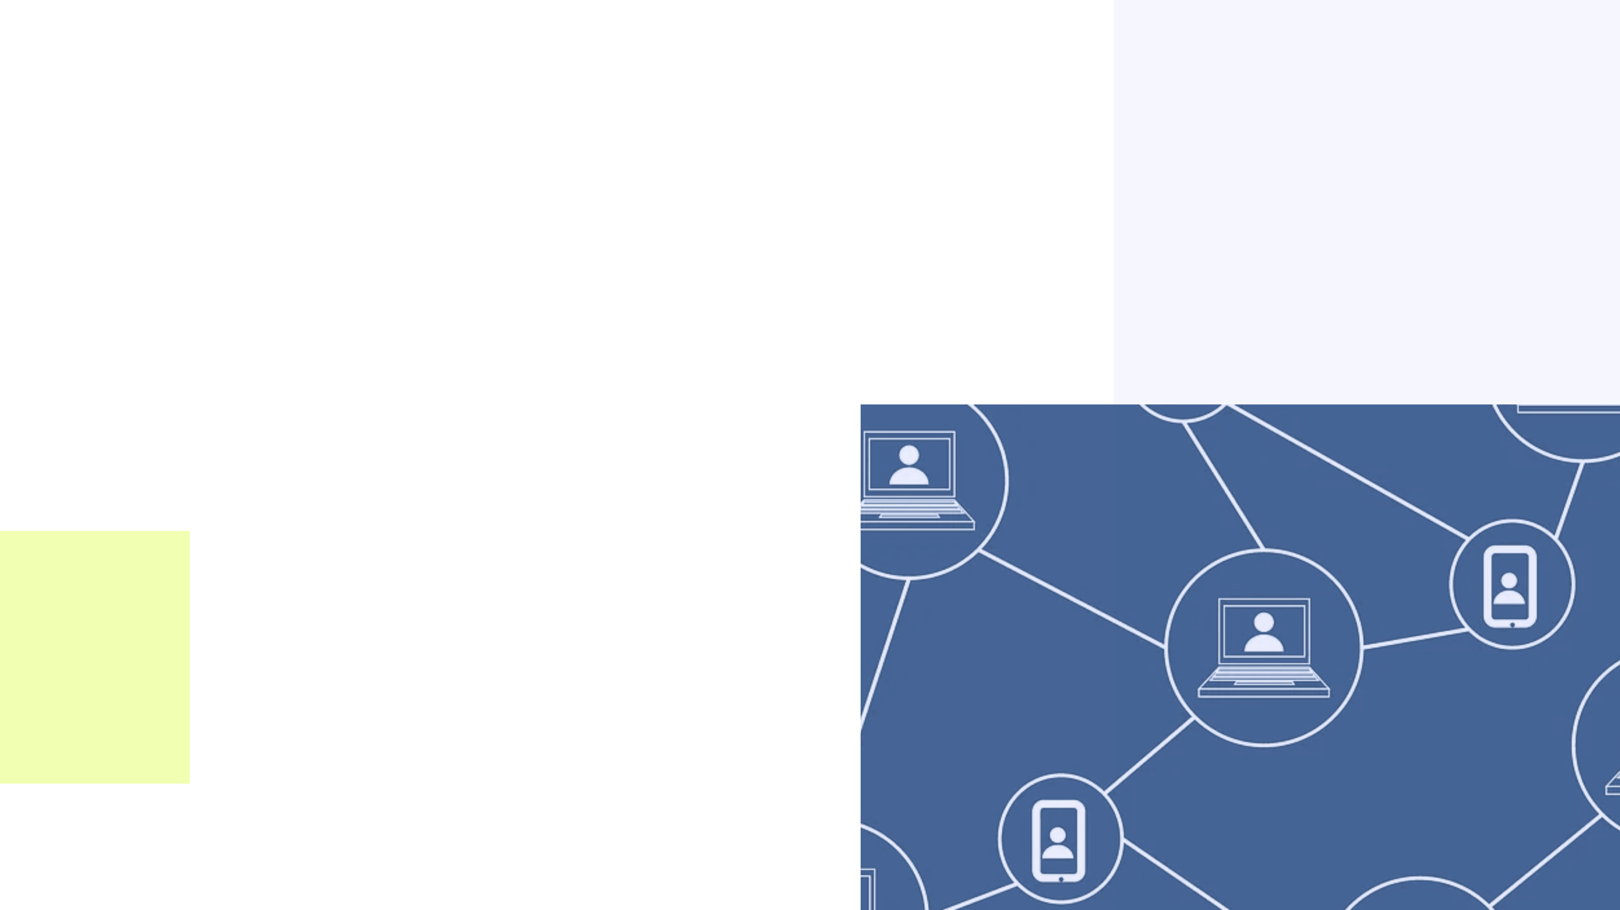

Our Vision
One-Click Capture of DeFi + RWA Diversified Yields
■
Composability
Unifying liquidity so users don't have to choose between real-time access and stable yields.
■
Observability
Replacing "black box" trust with verifiable, real-time data and transparent fee structures.
"Fuse Vault: The Yield Infrastructure Layer for Pharos."

Slide 5

HYBRID VAULT
Unlocking Composability
Unified Share Token
ERC4626
Users receive a single pvUSDC (ERC20) token regardless of the underlying strategy allocation. One token, dual yield sources.
Synchronous DeFi Settlement
+
Complete RWA Workflow
ERC7540
Implements the full lifecycle of real-world assets, ensuring compliance and reality.
Asynchronous RWA Requests
PENDING
→
CONFIRMED
→
CLAIMED
FUSE VAULT
Infinite Composability
Unified Protocol Layer
pvUSDC is fully composable. It can be staked, lent, or used as a base asset for other nested vaults in the ecosystem.

Slide 6
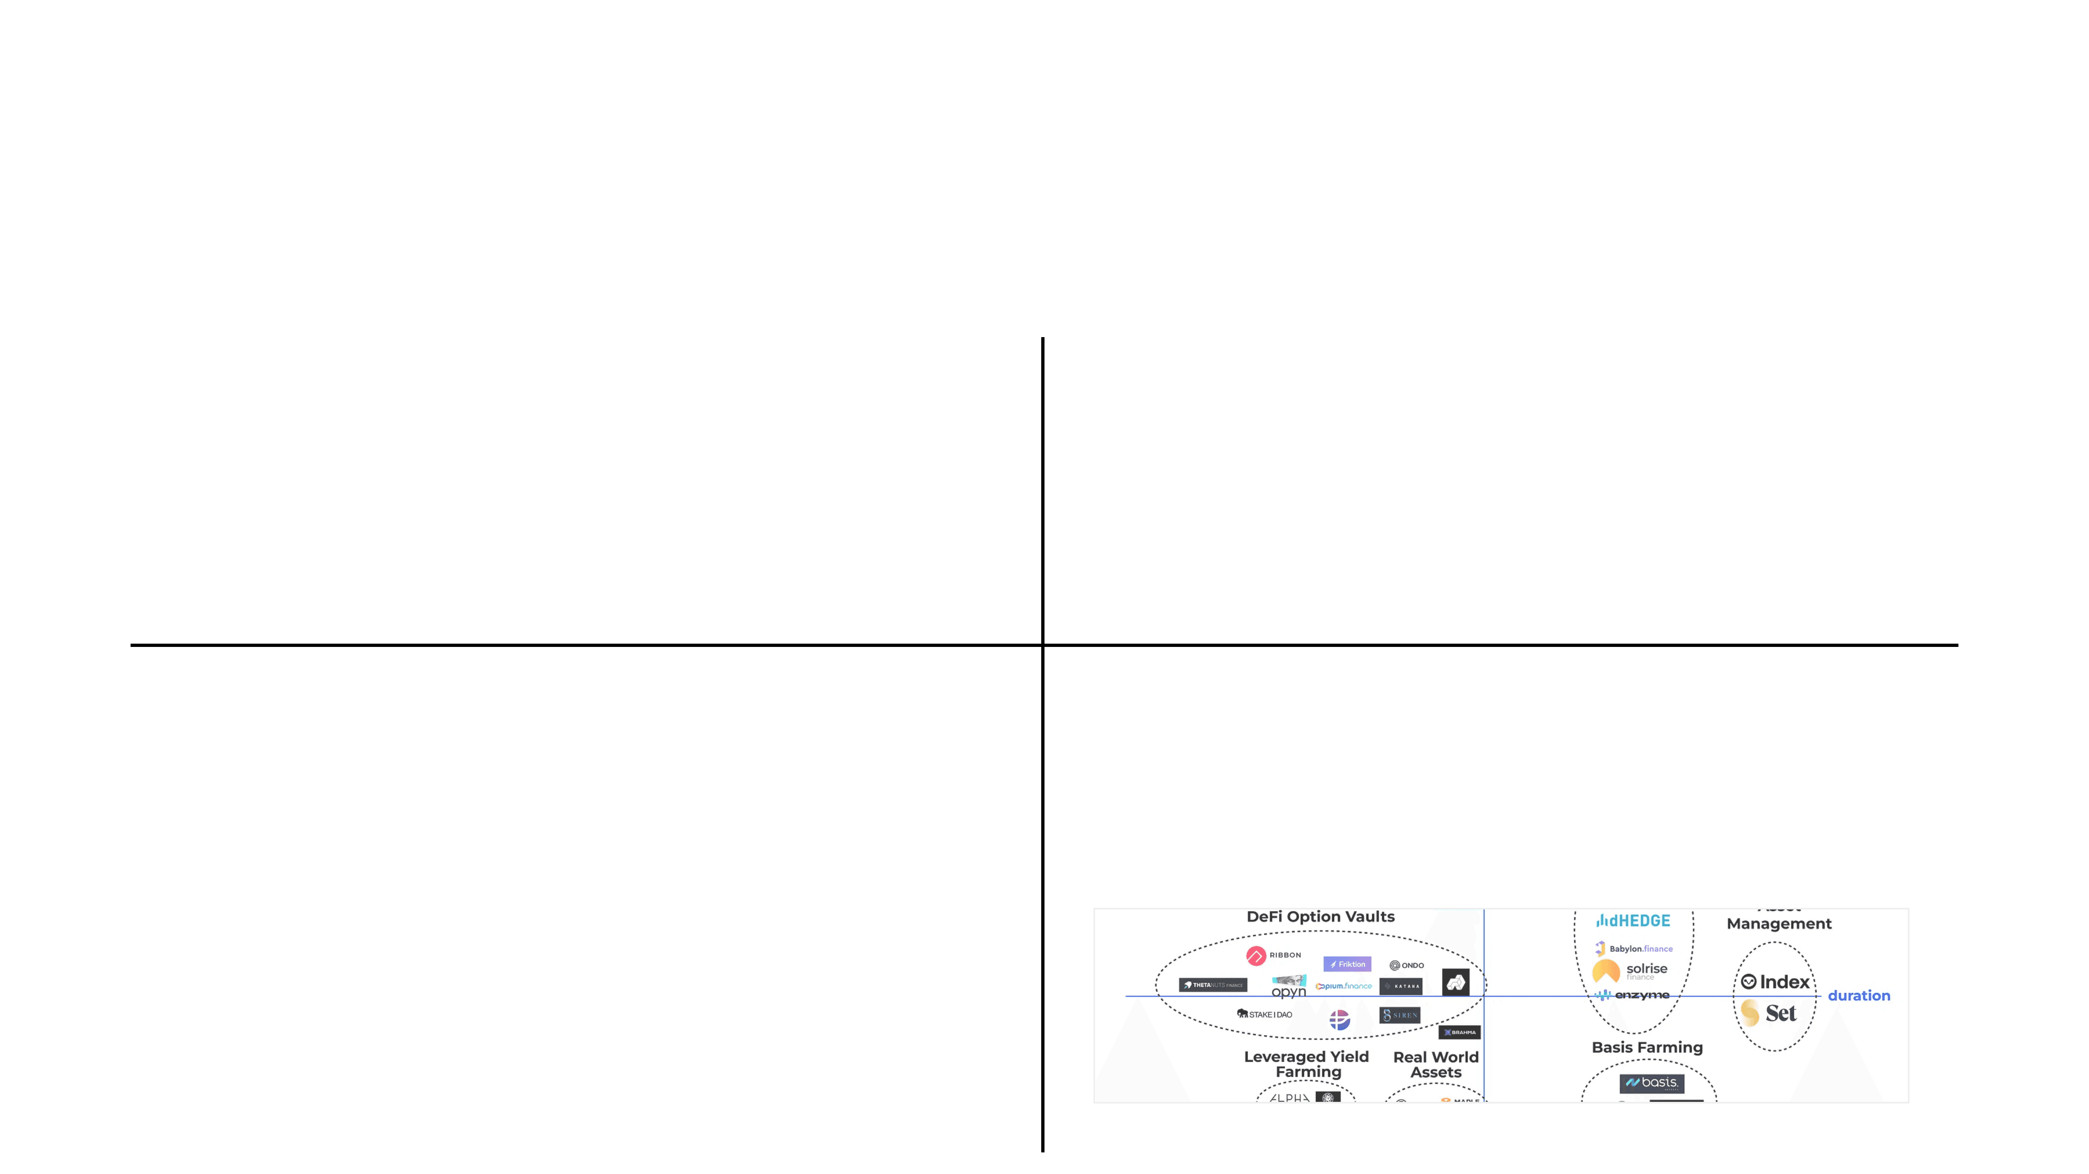




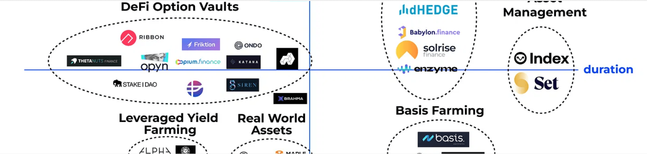
REAL-TIME OBSERVATORY
Ensuring Observability & Trust
Market Replay
Real-Time Metrics
Validate strategies using real historical data (BTC, Gold).
Live visualization of critical performance indicators.
1x ~ 100x Playback Speed
NAV Curve • PnL % • Max Drawdown
Transparent Fees
Pre-Invest Check
Fees are calculated per second and visualized on-chain.
Test with $100,000 Virtual Funds before committing real capital.
2% Management • 10% Performance
Market Data Structure

Slide 7

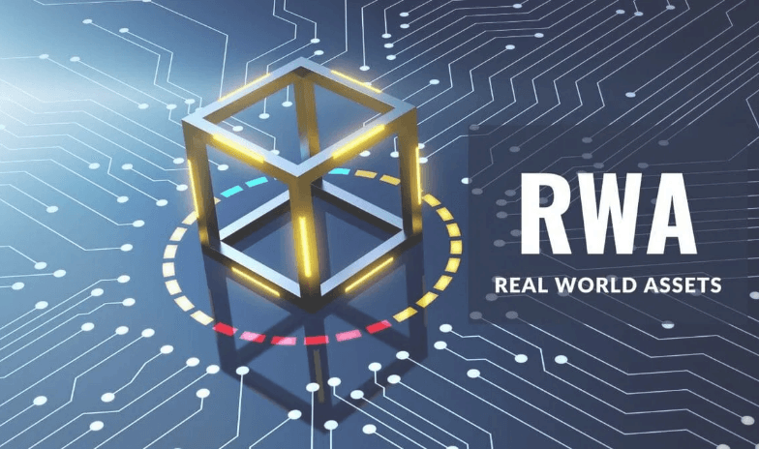
TECHNICAL ARCHITECTURE
User / External Protocols
Protocol Innovation
Hybrid protocol fusing ERC4626 (Sync) and ERC7540 (Async) in a single contract state machine.
Unified Share Token (pvUSDC)
Real-Time Observatory (Market Replay)
Composability
Fuse Vault (Hybrid Protocol)
Unified ERC20 share token (pvUSDC) ensures seamless integration with DeFi lending and DEXs.
DeFi Strategy
(Sync Settlement)
RWA Strategy
(Async Settlement)
Observability
Real-Time Observatory engine powered by historical market replay data.

Slide 8

HACKATHON REQUIREMENTS
100% COMPLETE
Vault Standard
Innovative Hybrid Protocol: ERC4626 + ERC7540 Fusion
Real Strategy
DeFi + RWA Strategies with complete Operator Workflow
Dynamic Fees
2% Management + 10% Performance Fee, Auto-Accrued
Transparency
Full Visualization: TVL, NAV, PnL, Drawdown & Fees
Composability
Unified ERC20 Share Token, Nested Vaults Support

Slide 9

BUSINESS VALUE & MARKET OPPORTUNITY
Revenue Model
Market Opportunity
2%
RWA Explosion
Tokenized Treasury market exceeds $2 Billion. Traditional finance is accelerating on-chain adoption.
Management Fee
Accrued per second from NAV. Stable income.
The Yield Gap
10%
Users currently choose between DeFi (volatile) and RWA (stable). Fuse Vault bridges this gap.
Infrastructure Layer
Performance Fee
Positioned as the foundational yield layer for the Pharos ecosystem, capturing value from all downstream apps.
Charged on excess yield (High Watermark).

Slide 10

ECOSYSTEM POSITIONING
The Yield Infrastructure Layer for Pharos
Upwards: Application Layer
Network Effect
Lending Collateral
DEX Liquidity
Derivatives
↓
Value amplifies as more
strategies plug in and
Core: Fuse Vault
INFRASTRUCTURE
more apps adopt the
share token.
Yield Aggregation
Risk Normalization
Unified Token
↓
Downwards: Strategy Layer
RWA Protocols
DeFi Protocols
Other Vaults

Slide 11
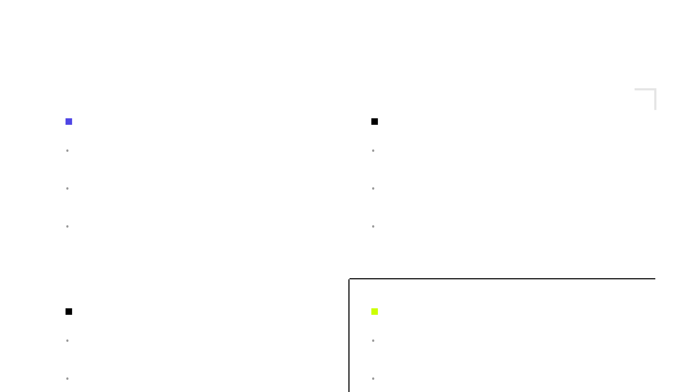
CORE ADVANTAGES
Technical Innovation
User Value
•
Hybrid Protocol
•
: First-ever fusion of ERC4626 & ERC7540.
One-Click Yield
: No need to manage separate DeFi/RWA positions.
•
Unified Token
•
: Single share token for dual yield sources.
Full Transparency
: Real-time visibility into NAV, fees, and drawdowns.
•
Market Replay
•
: Validation engine using real historical data.
Pre-Invest Check
: Verify strategies with virtual funds first.
Ecosystem Value
Business Value
•
Downward Open
•
: Any RWA/DeFi protocol can plug in as a strategy.
Clear Model
: 2% Management Fee + 10% Performance Fee.
•
Upward Compatible
•
: Share tokens usable in Lending/DEXs.
Scale Effect
: Revenue grows linearly with TVL.
•
Sustainable
: Automated operations ensure low marginal costs.
•
Horizontal Scale
: Supports nested vaults for structured products.

Slide 12
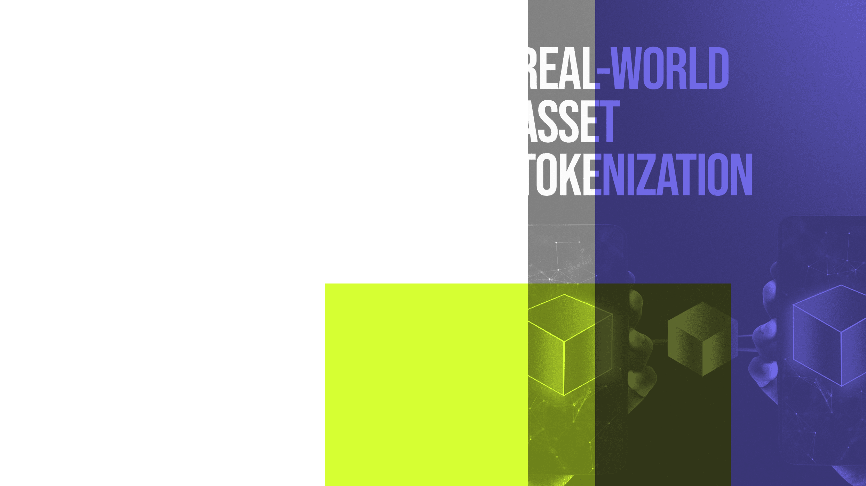
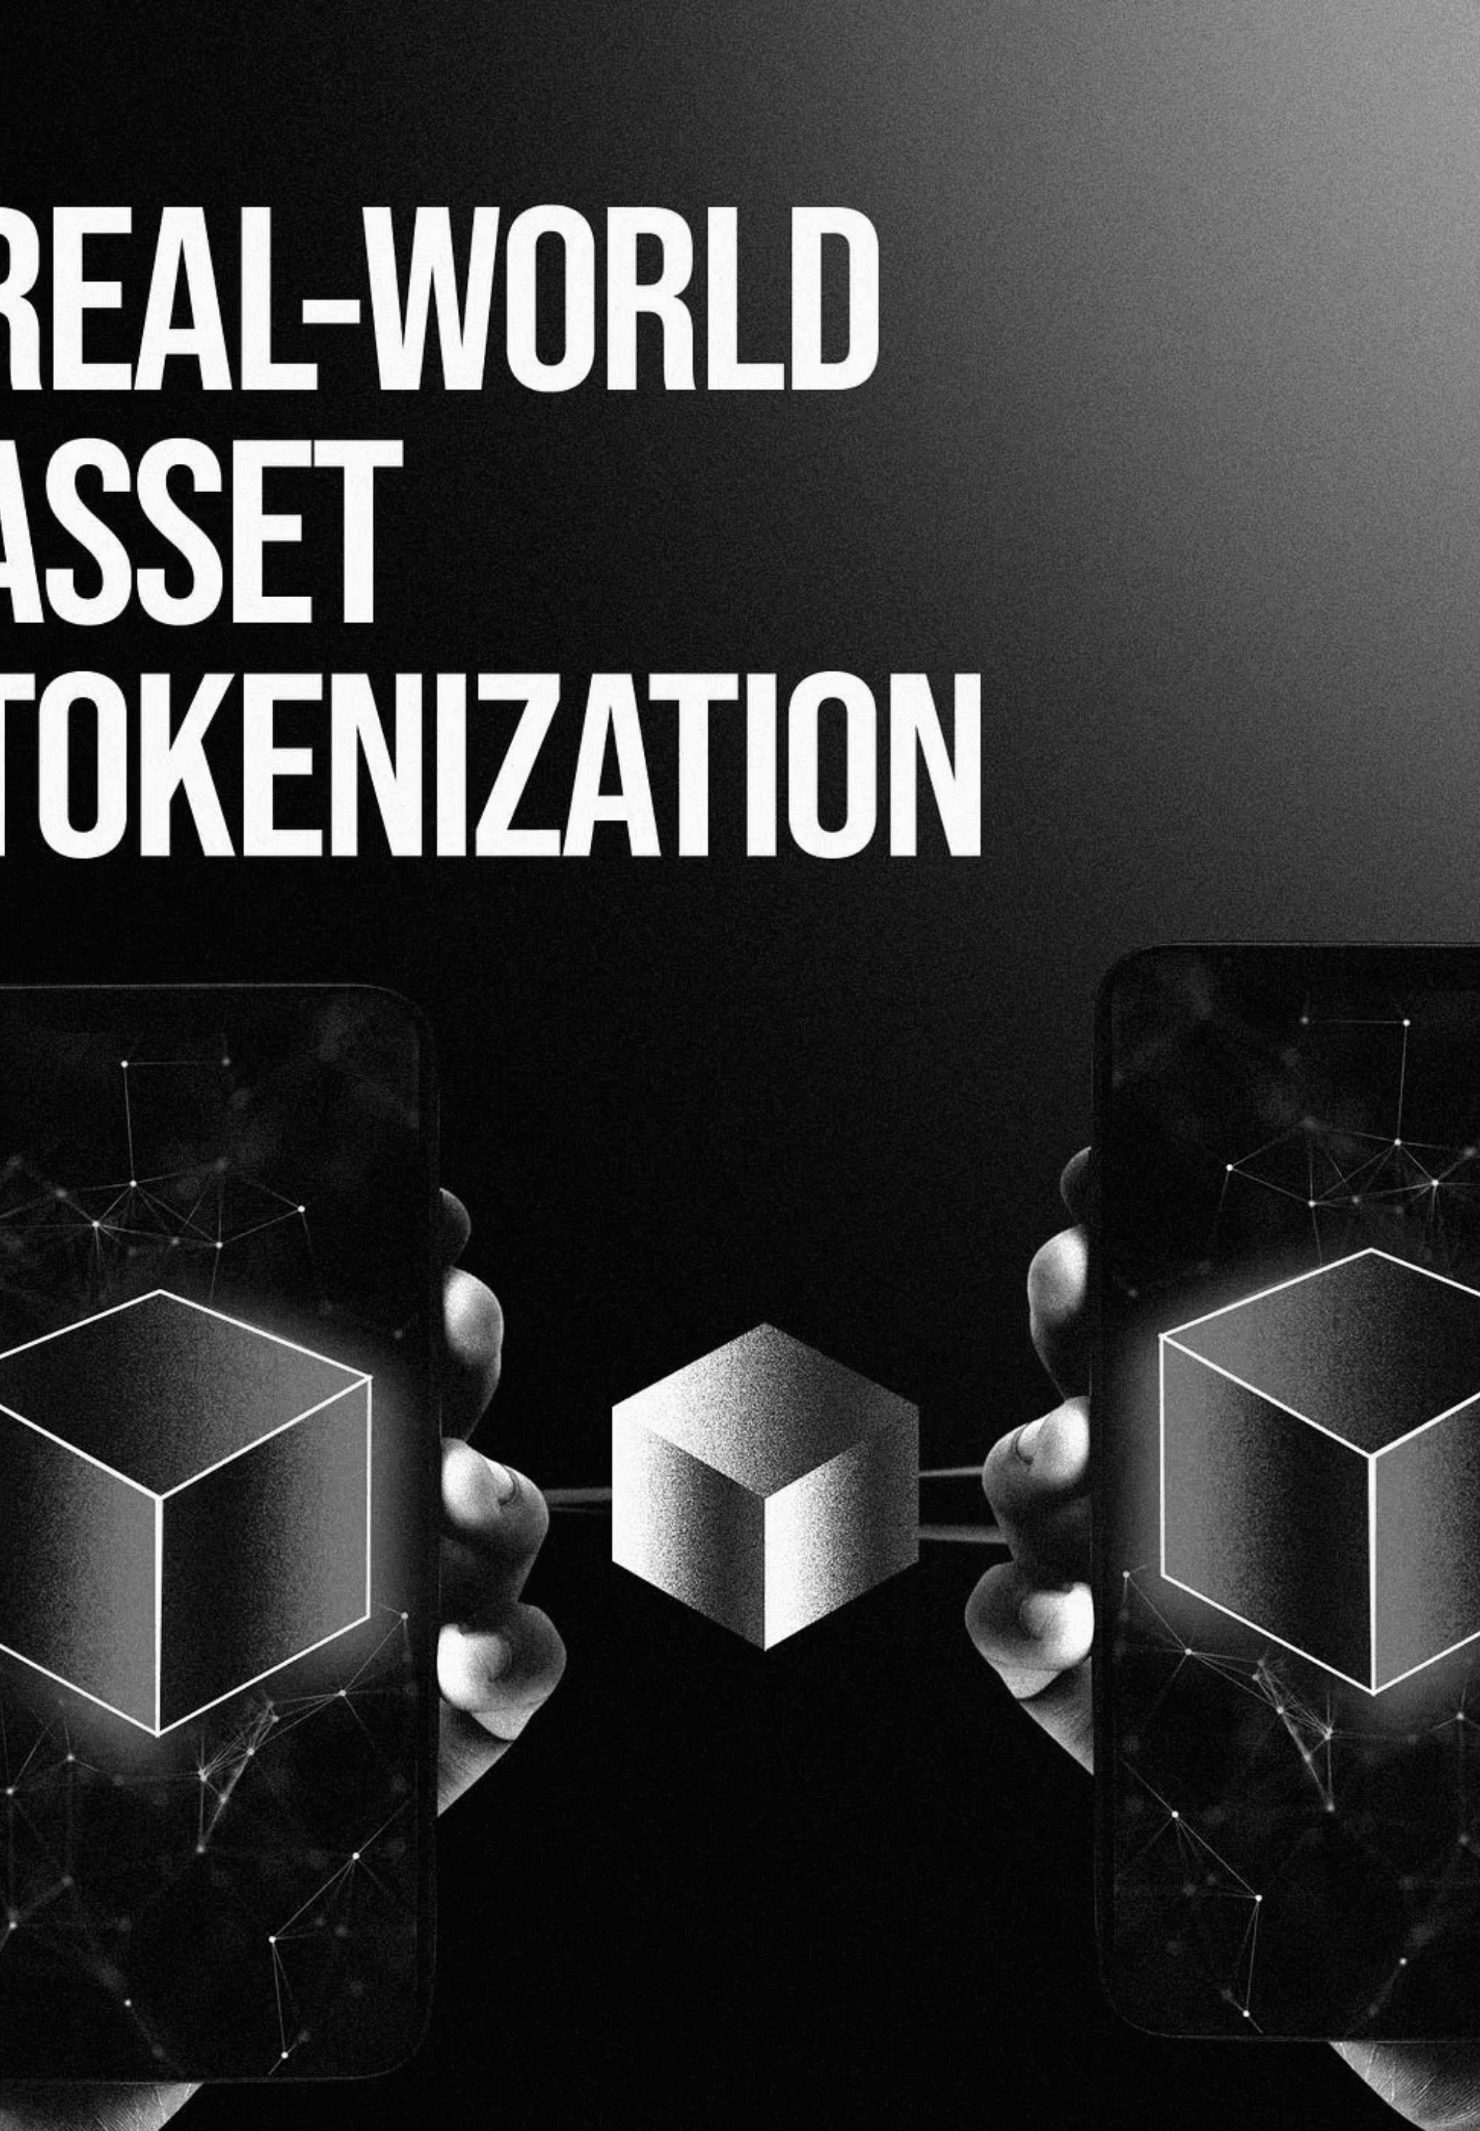

THE FUTURE OF YIELD
Fuse Vault Mission
One-Click Capture of DeFi + RWA Diversified Yields
Investment Decisions Based on Transparent, Verifiable Data
Live on Testnet
The Yield Infrastructure Layer for the Pharos Ecosystem
Try with $100,000 Virtual Funds
Experience the Market Replay Engine today.
Cauchy | 卢博文 | 唐彬杰 | Peggy
Built for 2026 GWDC Hackathon

